Slide 1
ELUCIDATING DRUG-DRUG INTERACTIONS UNDERLYING DRUG POLYPHARMACY PROFILES
UNIVERSITY OF COPENHAGEN
FACULTY OF HEALTH AND MEDICAL SCIENCES

Slide 2
Summary
Part I Building a compendia of DDIs information from public databases
Part II Comparison between the different data sources: scattered DDI knowledge
Part III Evaluation of the frequency of DDI in clinical practice using Electronic Health Records

Slide 3
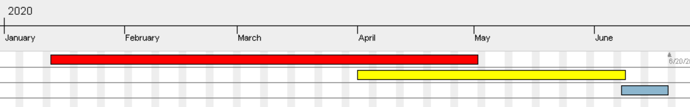
TIMELINE
Reading papers
Extracting and tidying data.
Part II
Part III
Phase 1; DDI Compendia
Phase 2; Computational analysis
Phase 3; TFG

Slide 4
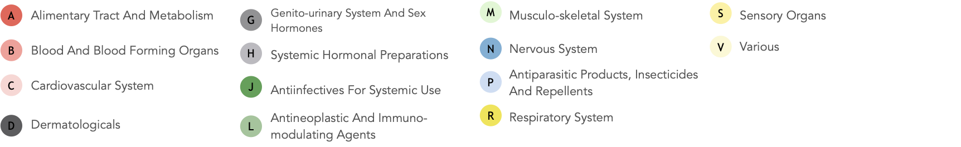
Detection of drug-drug interactions in clinical setting
Legend nodes:
Drug combinations from electronic health records
Drug interaction from publicly available databases
Legend edges:
Avoid combination
Combination needs monitoring
Combination is ok

Slide 5

Part III
DDI COMPENDIA
DDI CLINICAL DATA
4.288 unique drugs
2.558.568 unique DDIs
1058 unique drugs
124.786 unique Drug combinations

Slide 6
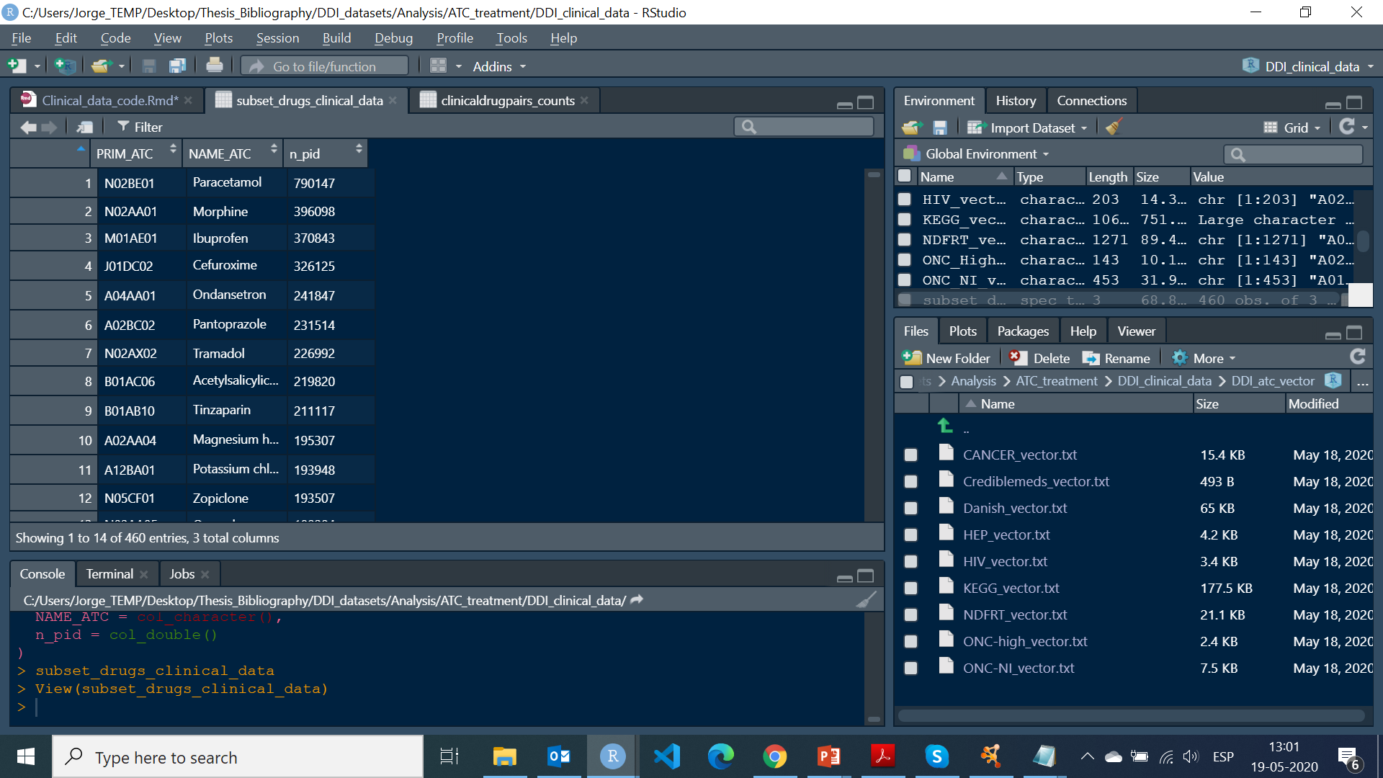
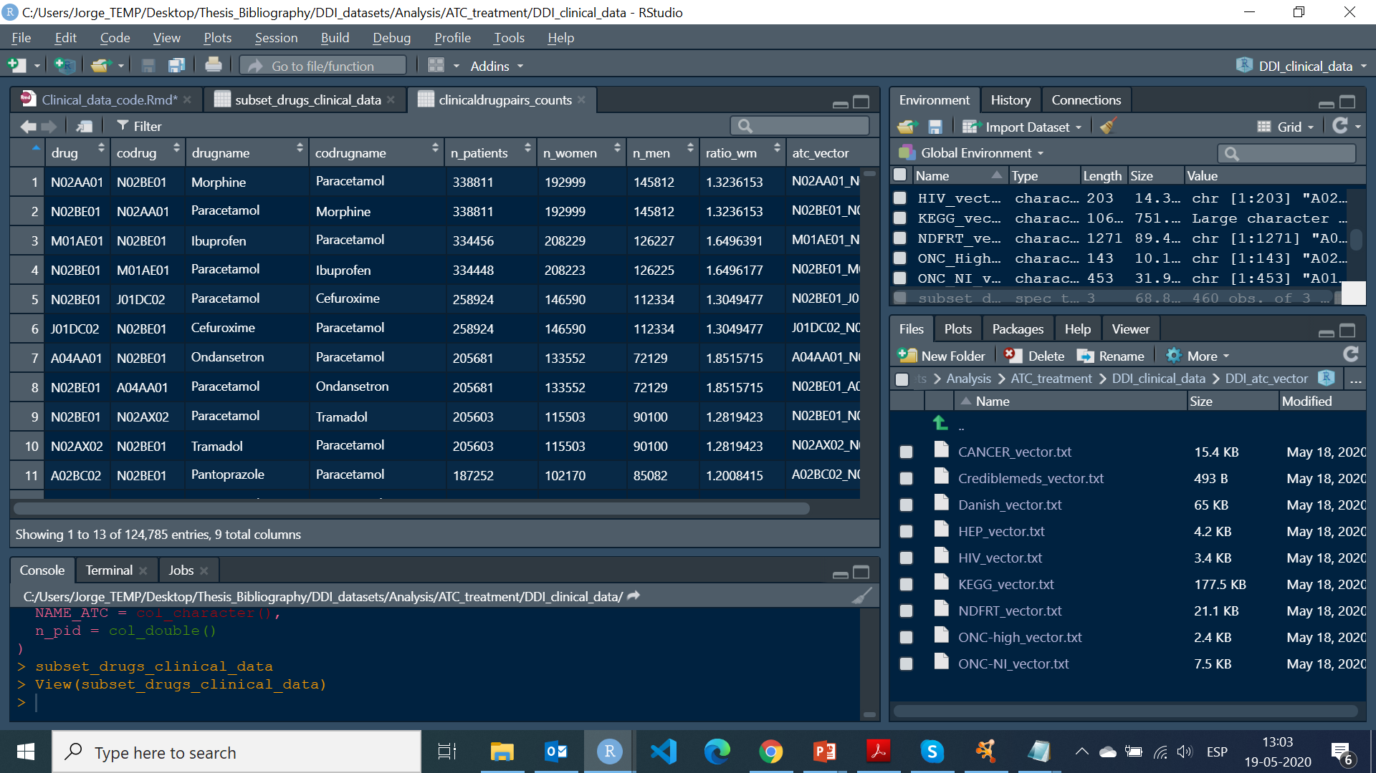
clinical data
Single drug information
Elements to be used in posterior analyses:
n_pid as the number of patient being administrated the drug
n_patients as the number of patients being administrated the drug combination
n_women and n_men could be used to isolate by gender
Drug combination information

Slide 7
compendia car-wash data
 | Extended Description | Clinical significance | Mechanism of action | Therapeutical effect | Side effect | Evidence level | Type of DDI | Management
DrugBank | X
KEGG | X |  | X |  |  |  |  | X
NDF-RT |  | X
TWOSIDES |  |  |  |  | X
Crediblemeds |  |  | X |  | X |  |  | X
ONC High |  | X |  |  |  | X |  | X
ONC NI |  |  |  |  |  | X
Danish_DDI | X | X |  |  |  | X |  | X
HIV | X | X |  |  |  | X
HEP | X | X |  |  |  | X
CANCER | X | X |  |  |  | X
DDI corpus 2011 | X
DDI corpus 2013 | X |  |  |  |  |  | X
NLM corpus | X
PK corpus | X
PHAEDRA corpus | X |  |  | X | X

Slide 8
Criteria
DDI Features
Available in several databases
Feasible to be used in clustering approaches
Feasible to be simply factorised.
Selected
Clinical significance
Mechanism of action
Evidence level
Management
Side effect (Tricky information to work with)

Slide 9
DDI features of clinical car-wash
 | Clinical significance | Mechanism of action | Evidence level | Management
KEGG |  | X |  | X
NDF-RT | X
TWOSIDES
Crediblemeds |  | X |  | X
ONC High | X |  | X | X
ONC NI |  |  | X
Danish_DDI | X |  | X | X
HIV | X |  | X
HEP | X |  | X
CANCER | X |  | X

Slide 10
Exploring the features
EVIDENCE LEVEL
Database | Values
HIV | Very low Low Moderate High
HEP
CANCER
DANISH DDI | Veldokumenteret Dokumenteret Begrænset dokumenteret Ringe dokumenteret
ONC-HIGH | Few documented case reports
ONC-NI | Reviewed by expert
CLINICAL SIGNIFICANCE
Database | Values
HIV | No interaction expected Potential weak interaction Potential interaction Do not coadminister
HEP
CANCER
DANISH DDI | Uafklaret, Ingen Mulig, Ringe Moderat, Udalt
ONC-HIGH | Highly significant
NDFRT | Critical Significant
MANAGEMENT
Database | Values
CREDIBLEMEDS | Usually avoid Take precautions
DANISH DDI | 1,2,3,4,5,7
KEGG | Contraindicated (CI) Precaution (P)
ONC-HIGH | Contraindicated
Mechanism of action
Database | Values
CREDIBLEMEDS | CYP inhibition Transporter inhibition
KEGG | CYP induction/inhibition Transporter induction/inhibition Target(gene)/(enzyme)

Slide 11
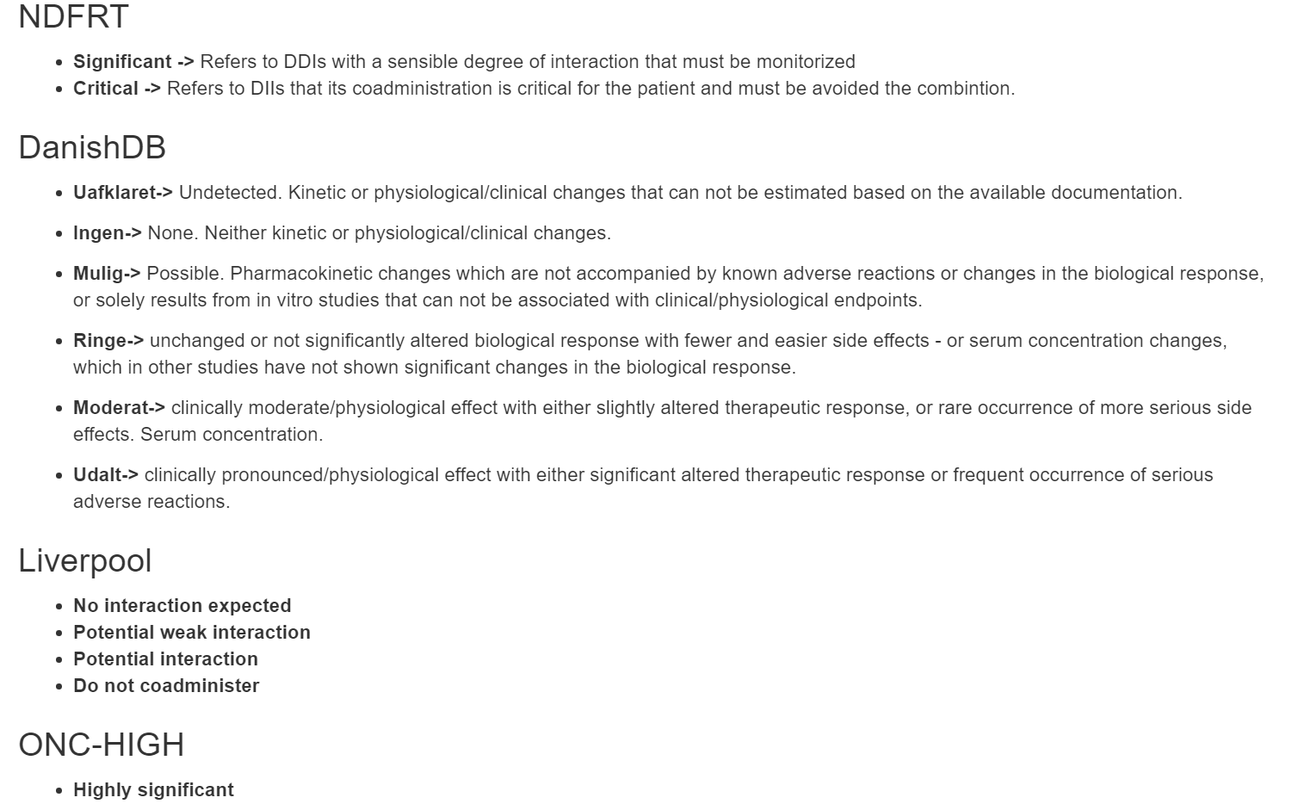
Factorization
Example of clinical significance feature

Slide 12
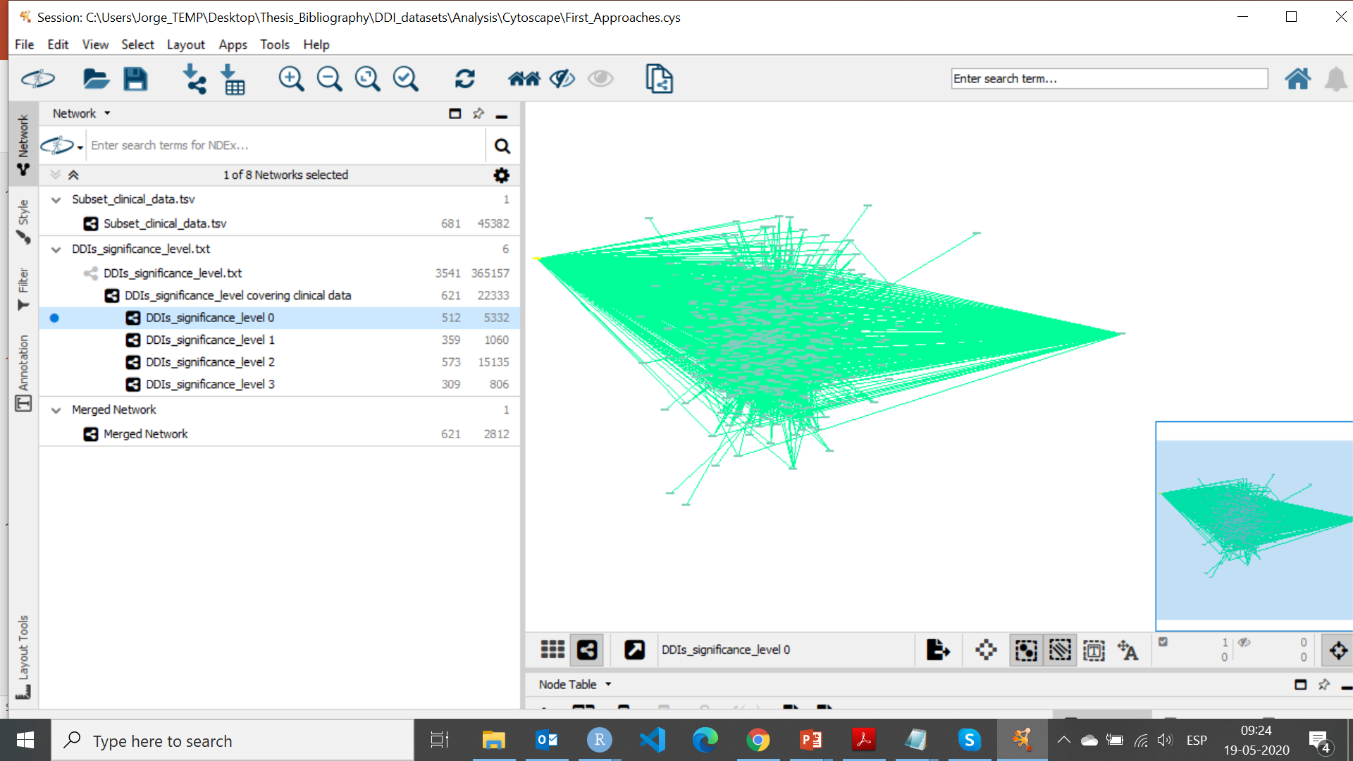
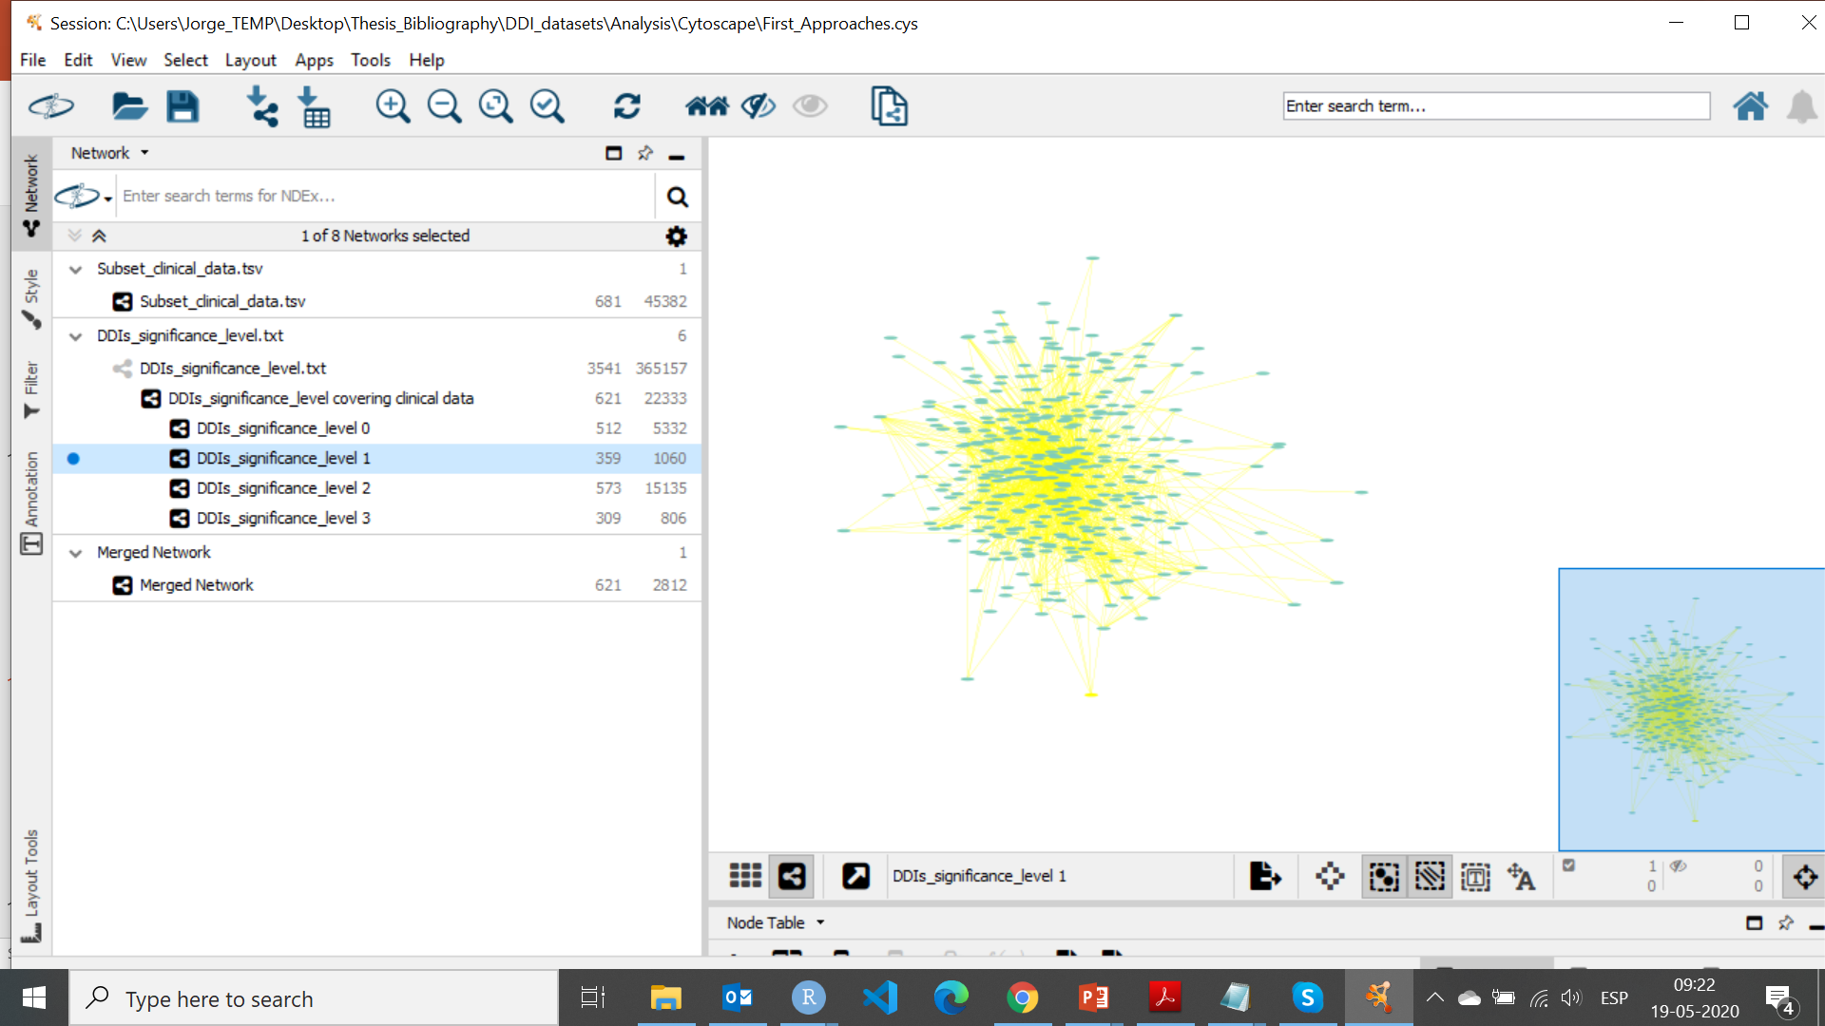
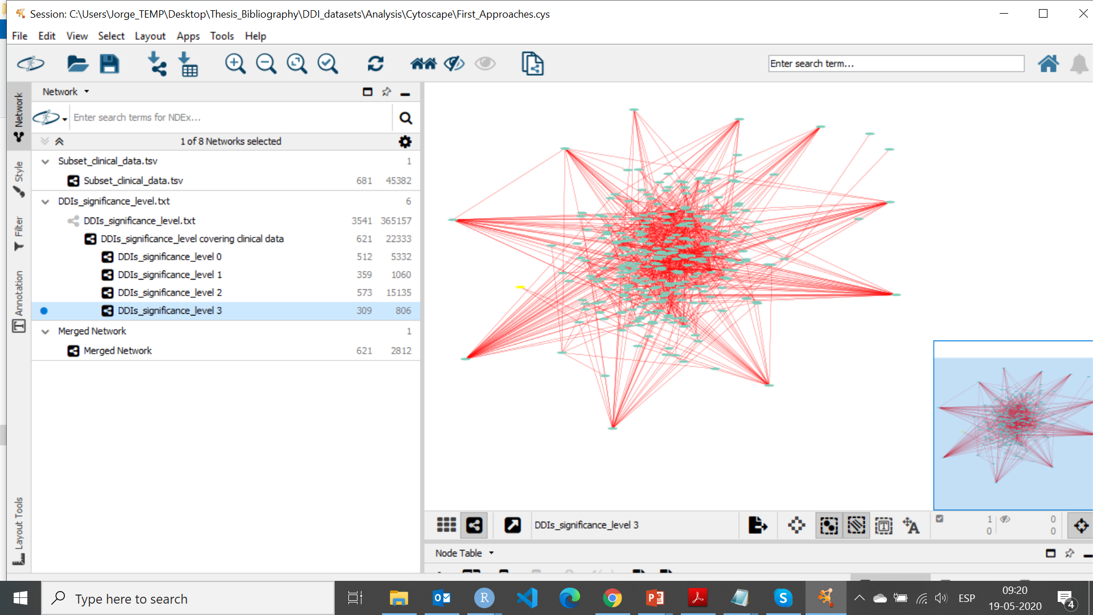
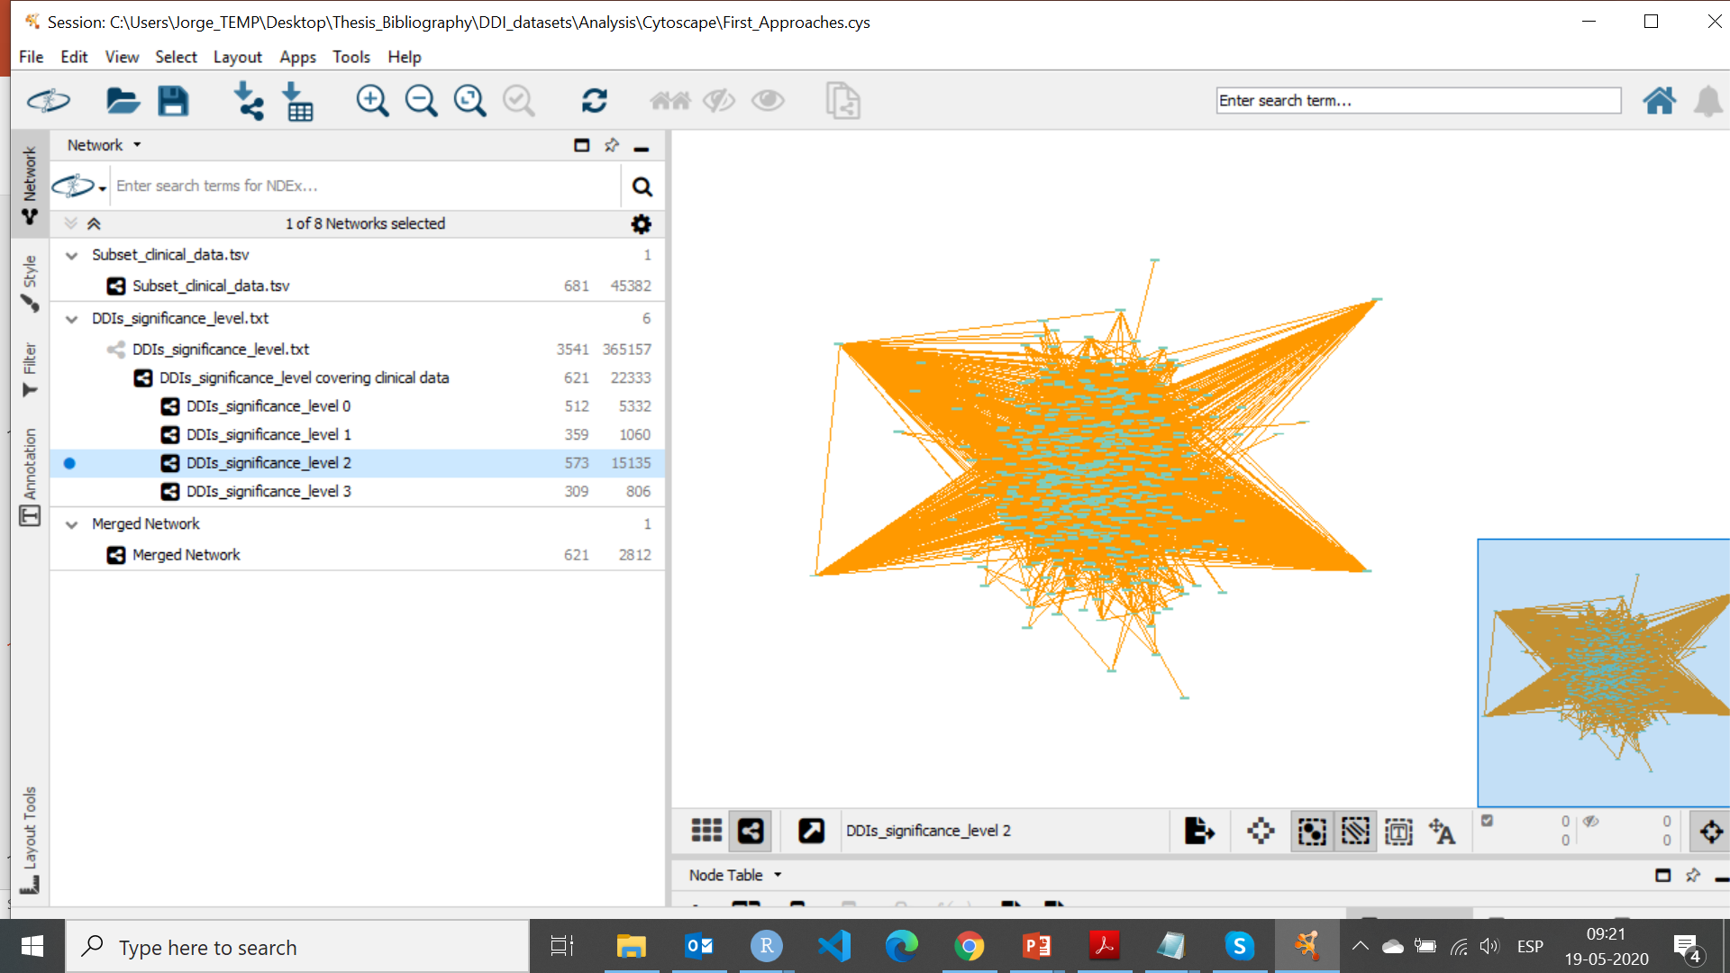
FUTURE ANALYSIS; examples
Hot hubs; clinical significance factors
Complementation of clinical data with clinical significance factors
n_patient
n_pid

Slide 13
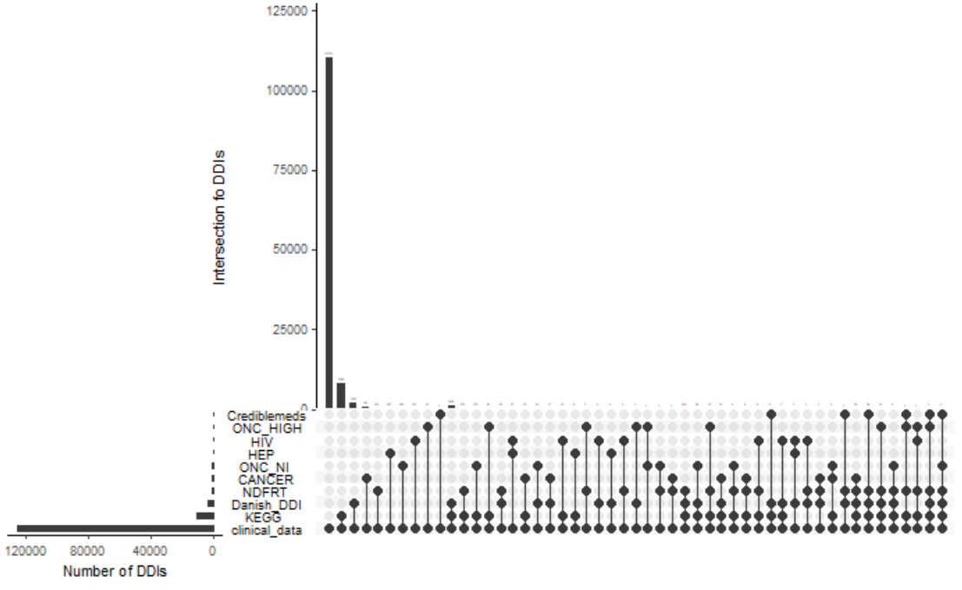
Drug combinations from clinical data barely identified as DDIs
CLINICAL DATA ORIGINAL
Nº Drugs | 1.058
Nº drug combination | 124.786
CLINICAL DATA MAPPED
Nº Drugs | 724
Nº DDIs identified | 14.572
FEATURES COVERAGE
Clinical significance | 6.891
Evidence level | 6.051
Management | 10.993
Mechanism of action | 8.757

Slide 14
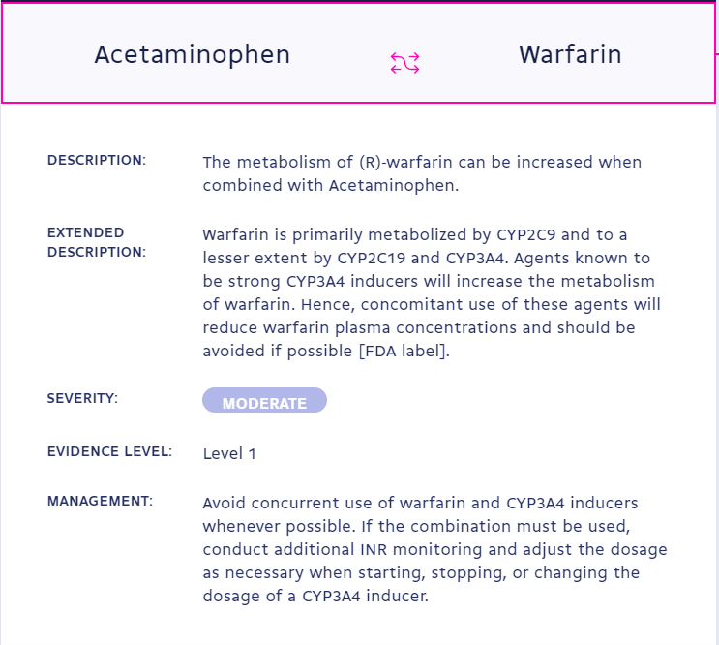
DRUGBANK
Biggest database I have in my compendia.
Potential features:
Severity as clinical significance
Evidence level
Management (Carefully)

Slide 15
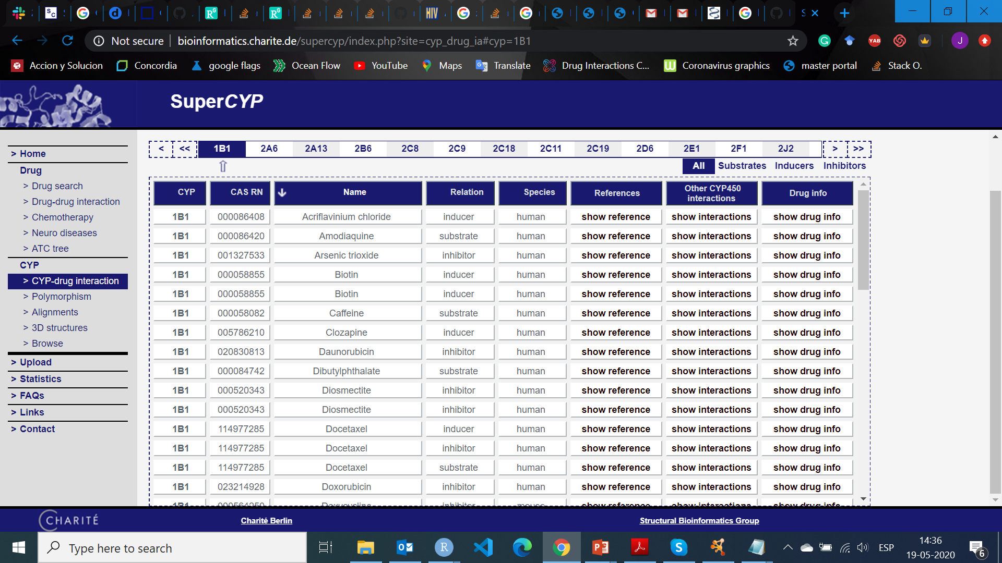
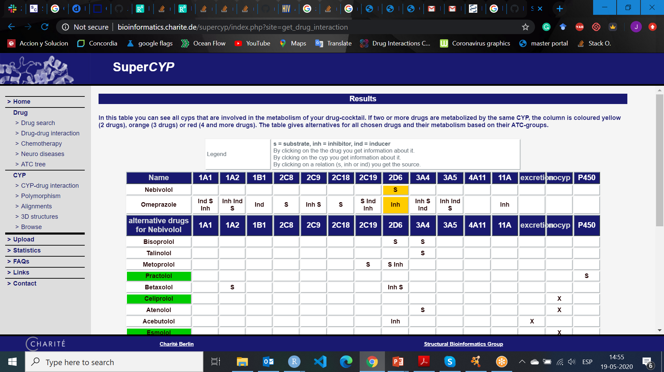
SUPERCYP
Each CYP action comes from text abstracts of PubMed.
Really comprehensive pharmacokinetic database
Mechanism of Action
Substrate - substrate
Substrate - inducer
Substrate - inhibitor
Inducer - inducer
Inhibitor – inhibitor

Slide 17
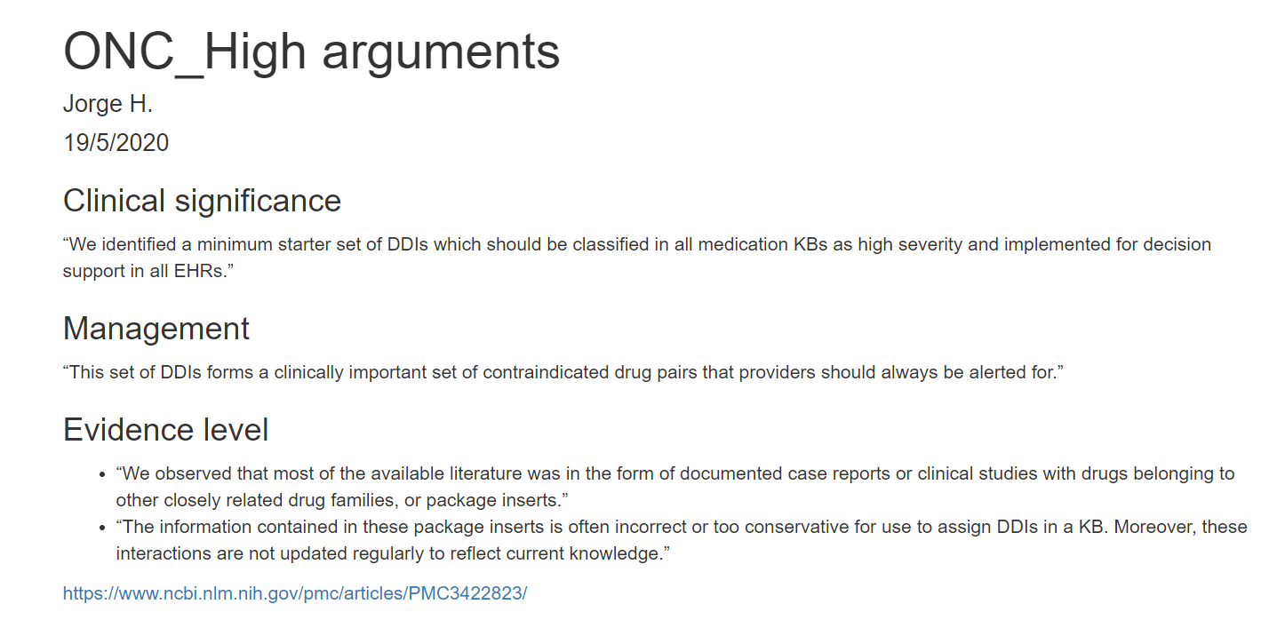
ONC-HIGH

Slide 18
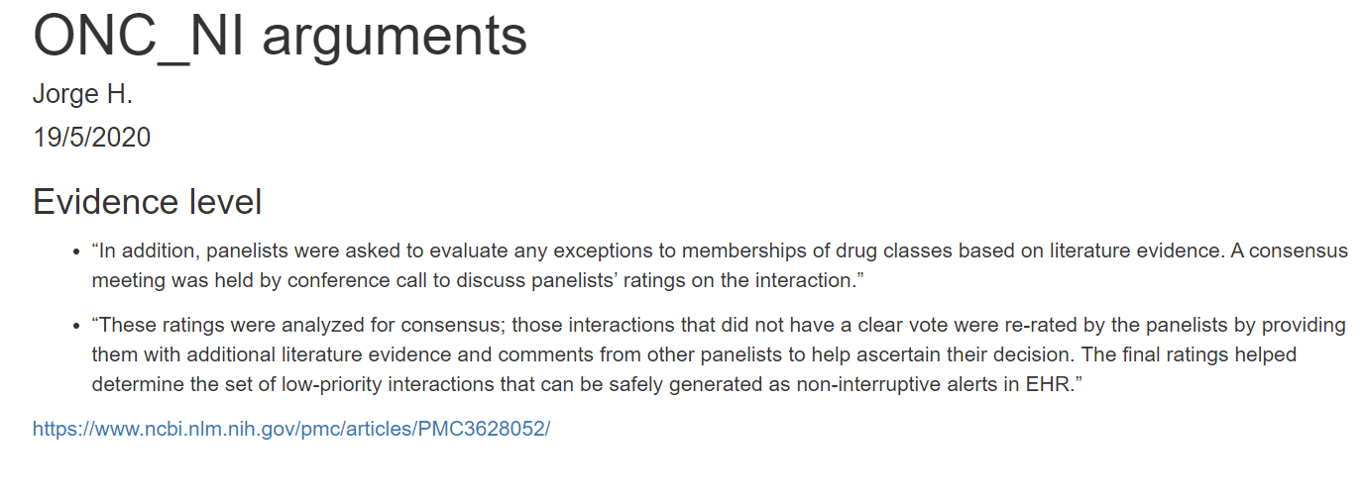
ONC NI

Slide 19
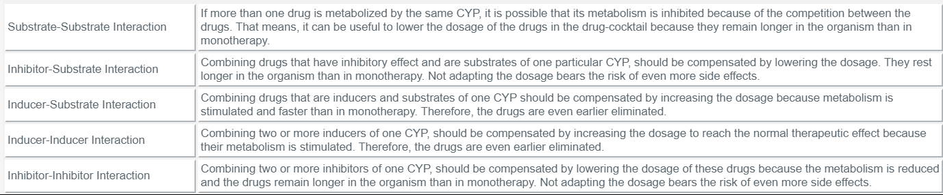
SUPERCYP

